Slide 1
CPT-S 415
Big Data
Yinghui Wu
EME B45

Slide 2
CPT_S 415
Big Data
Data security and privacy
Information Security: basic concepts
Privacy: basic concepts and comparison with security

Slide 3
Information security

Slide 4
Information Protection - Why?
Information: important strategic and operational asset for any organization
Damages and misuses of information affect not only a single user or an application; they may have disastrous consequences on the entire organization
Additionally, the advent of the Internet as well as networking capabilities has made the access to information much easier

Slide 5
Information Security: Examples
Consider a payroll database in a corporation, it must be ensured that:
  salaries of individual employees are not disclosed to arbitrary users of the database
  salaries are modified by only those individuals that are properly authorized
  paychecks are printed on time at the end of each pay period
In a military environment, it is critical that:
  the target of a missile is not given to an unauthorized user
  the target is not arbitrarily modified
  the missile is launched when it is fired

Slide 6
Information Security: Main
Requirements
Confidentiality ^{Information}
Security
Integrity
Availability

Slide 7
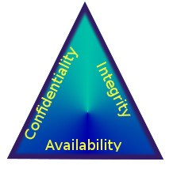
Information Security - main requirements
Confidentiality - information protection from unauthorized read operations
  – the term privacy is often used when data to be protected refer to individuals
Integrity - information protection from modifications; it involves several goals:
  Assuring the integrity of information with respect to the original information (relevant especially in web environment) – often referred to as authenticity
  Protecting information from unauthorized modifications
  Protecting information from incorrect modifications – referred to as semantic integrity
Availability - it ensures that access to information is not denied to authorized subjects
FEARLESS engineering

Slide 8
Information Security – additional requirements
Information Quality – not considered traditionally as part of information security but it is very relevant
Completeness – it refers to ensure that subjects receive all information they are entitled to access, according to the stated security policies

Slide 9
Classes of Threats
Disclosure – unauthorized access to information
  Snooping, Trojan Horses
    counted by Confidentiality & Integrity
Deception – acceptance of false data
  Modification, spoofing, repudiation of origin, denial of receipt
    counted by Integrity & availability
Disruption - interruption or prevention of correct operation
  Modification
    counted by Integrity & availability
Usurpation - unauthorized control of some part of a system
  Spoofing, Delay, denial of service
    counted by Integrity & availability

Slide 10
Goals of Security
Prevention
  Prevent attackers from violating security policy
Detection
  Detect attackers’ violation of security policy
Recovery
  Stop attack, assess and repair damage
  Continue to function correctly even if attack succeeds
FEARLESS engineering

Slide 11
Information Security – How?
Information must be protected at various levels:
  The operating system
  The network
  The data management system
  Physical protection is also important
FEARLESS engineering

Slide 12
Information Security – Mechanisms
Confidentiality is enforced by the access control mechanism
Integrity is enforced by the access control mechanism and by the semantic integrity constraints (domain, type, constraints)
Availability is enforced by the recovery mechanism and by detection techniques for DoS attacks – an example of which is query flood

Slide 13
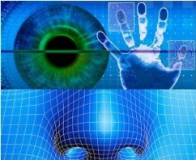
Information Security – How? Additional mechanisms
User authentication - to verify the identity of subjects wishing to access the information
Information authentication - to ensure information authenticity - it is supported by signature mechanisms (e.g., RSA signature keys)
Encryption - to protect information when being transmitted across systems and when being stored on secondary storage
Intrusion detection – to protect against impersonation of legitimate users and also against insider threats

Slide 14
Access Control
Problem Statement: authorizing data access scopes (relations, attributes, tuples) to users of DBMS
Discretionary access control
  Authorization administration policies, ie, granting and revoking authorization (centralized, ownership, etc)
  Content-based using views and rewriting for fine-grained access control
  Role-based access control: a function with a set of actions, consisting of users members
Mandatory access control:
  Object and subject classification (eg, top secret, secret, unclassified, etc).

Slide 15
Information Security: A Complete Solution
It consists of:
  first defining a security policy
  then choosing some mechanism to enforce the policy
  finally providing assurance that both the mechanism and the policy are sound
SECURITY LIFE-CYCLE

Slide 16
Data Privacy

Slide 17
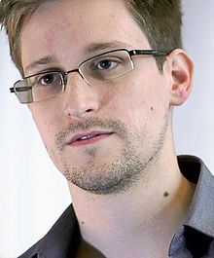
Big data: Is Our Security Keeping Pace?
Example:
Edward Snowden
He worked for the CIA and then NSA and leaked thousands of classified documents to media outlets.
The documents showed details of a global surveillance program, especially the mass collection of phone data.

Slide 18
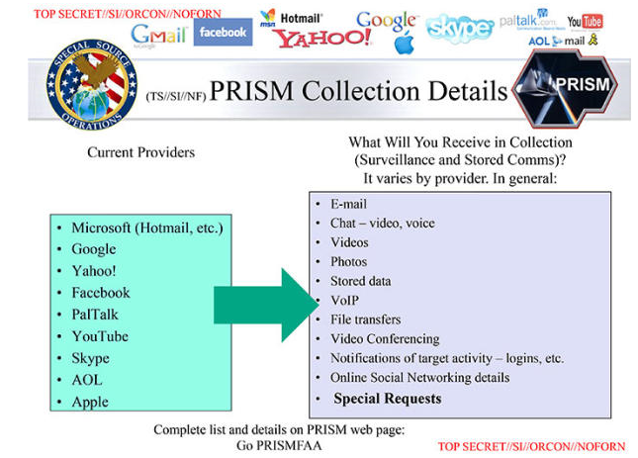
PRISM project

Slide 19
Need for Privacy Guarantees
By individuals [Cran et al. ‘99]
  99% unwilling to reveal their SSN
  18% unwilling to reveal their… favorite TV show
By businesses
  Online consumers worrying about revealing personal data
  held back $15 billion in online revenue in 2001
By Federal government
  Privacy Act of 1974 for Federal agencies
  Health Insurance Portability and Accountability Act of 1996 (HIPAA)

Slide 20
Need for Privacy Guarantees
By computer industry research (examples)
  Microsoft Research
    The biggest research challenges:
      Reliability / Security / Privacy / Business Integrity
    => MS Trustworthy Computing Initiative
    Topics include: DRM—digital rights management (incl. watermarking surviving photo editing attacks), software rights protection, intellectual property and content protection, database privacy and p.-p. data mining, anonymous e-cash, anti-spyware
  IBM
    Topics include: pseudonymity for e-commerce, EPA and EPAL—enterprise privacy architecture and language, RFID privacy, p.-p. video surveillance, federated identity management (for enterprise federations), p.-p. data mining and p.-p.mining of association rules, hippocratic (p.-p.) databases, online privacy monitoring

Slide 21
Need for Privacy Guarantees
By academic researchers (examples from the U.S.A.)
  CMU and Privacy Technology Center
    Latanya Sweeney (k-anonymity, SOS—Surveillance of Surveillances, genomic privacy)
    Mike Reiter (Crowds – anonymity)
  Purdue University – CS and CERIAS
    Elisa Bertino (trust negotiation languages and privacy)
    Bharat Bhargava (privacy-trust tradeoff, privacy metrics, p.-p. data dissemination, p.-p. location-based routing and services in networks)
    Chris Clifton (p.-p. data mining)
    Leszek Lilien (p.-p. data disemination)
  UIUC
    Roy Campbell (Mist – preserving location privacy in pervasive computing)
    Marianne Winslett (trust negotiation w/ controled release of private credentials)
  U. of North Carolina Charlotte
    Xintao Wu, Yongge Wang, Yuliang Zheng (p.-p. database testing and data mining)

Slide 22
Definition
Privacy is the ability of a person to control the availability of information about and exposure of him- or herself. It is related to being able to function in society anonymously.
Types of privacy giving raise to special concerns:
  Political privacy
  Consumer privacy
  Medical privacy
  Information technology end-user privacy; also called data privacy
  Private property
FEARLESS engineering

Slide 23
Data Privacy
Data Privacy problems exist wherever uniquely identifiable data relating to a person or persons are collected and stored, in digital form or otherwise.
Improper or non-existent disclosure control can be the root cause for privacy issues.
The most common sources of data affected by data privacy issues:
  Health information
  Criminal justice
  Financial information
  Genetic information

Slide 24
Data Privacy
The challenge in data privacy is to share data while protecting the personally identifiable information.
  Consider the example of health data which are collected from hospitals in a district; it is standard practice to share this only in aggregate form
  The idea of sharing the data in aggregate form is to ensure that only non-identifiable data are shared.
The legal protection of the right to privacy in general and of data privacy in particular varies greatly around the world.

Slide 25
Technologies with Privacy Concerns
Biometrics (DNA, fingerprints, iris) and face recognition
Video surveillance, ubiquitous networks and sensors
Cellular phones
Personal Robots
DNA sequences, Genomic Data

Slide 26
Threats to Privacy [cf. Simone Fischer-Hübner]
1) Threats to privacy at application level
Threats to collection / transmission of large quantities of personal data
    Health Networks / Public administration Networks
    Research Networks / Electronic Commerce / Teleworking
    Distance Learning / Private use
  Example: Information infrastructure for a better healthcare [cf. Danish "INFO-Society 2000"- or Bangemann-Report]
    National and European healthcare networks for the interchange of information
    Interchange of (standardized) electronic patient case files
    Systems for tele-diagnosing and clinical treatment

Slide 27
Threat to Privacy [cf. Simone Fischer-Hübner]
2) Threats to privacy at communication level
Threats to anonymity of sender / forwarder / receiver
Threats to anonymity of service provider
Threats to privacy of communication
  E.g., via monitoring / logging of transactional data
    Extraction of user profiles & its long-term storage
3) Threats to privacy at system level
E.g., threats at system access level
4) Threats to privacy in audit trails

Slide 28
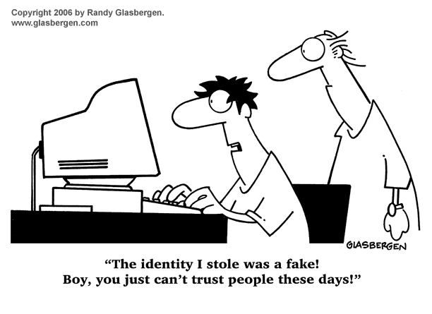
Threat to Privacy [cf. Simone Fischer-Hübner]
Identity theft – the most serious crime against privacy
Threats to privacy – another view
  Aggregation and data mining
  Poor system security
  Government threats
    Gov’t has a lot of people’s most private data
      Taxes / homeland security / etc.
    People’s privacy vs. homeland security concerns
  The Internet as privacy threat
    Unencrypted e-mail / web surfing / attacks
  Corporate rights and private business
    Companies may collect data that U.S. gov’t is not allowed to
  Privacy for sale - many traps
    “Free” is not free…
      E.g., accepting frequent-buyer cards reduces your privacy

Slide 29
Approaches in Privacy-Preserving Information Management
Anonymization Techniques
  Have been investigated in the areas of networks (see “the Anonymity Terminology” by Andreas Pfitzman) and databases (see the notion of “k-anonymity” by L. Sweeney)
Privacy-Preserving Data Mining
P3P policies (platform for privacy preference)
  Are tailored to the specification of privacy practices by organizations and to the specification user privacy preferences
Hippocratic Databases (Rakesh.A et al, VLDB 02)
  Are tailored to support privacy policies
Fine-Grained Access Control Techniques
Private Information Retrieval Techniques

Slide 30
Privacy vs Security
Privacy is not just confidentiality and integrity of user data
Privacy includes other requirements:
  Support for user preferences
  Support for obligation execution
  Usability
  Proof of compliance

Slide 31
Data Anonymization

Slide 32
Inference - Example
Name | Sex | Programme | Units | Grade Ave
Alma | F | MBA | 8 | 63
Bill | M | CS | 15 | 58
Carol | F | CS | 16 | 70
Don | M | MIS | 22 | 75
Errol | M | CS | 8 | 66
Flora | F | MIS | 16 | 81
Gala | F | MBA | 23 | 68
Homer | M | CS | 7 | 50
Igor | M | MIS | 21 | 70
Policy: average grade of a single student cannot be disclosed

Slide 33
Inference - Example
However, statistical summaries can be disclosed
Suppose that an attacker knows that Carol is a female CS student
By combining the results of the following legitimate queries:
  Q1: SELECT Count (*) FROM Students WHERE Sex =‘F’ AND Programme = ‘CS’
  Q2: SELECT Avg (Grade Ave) FROM Students WHERE Sex =‘F’ AND Programme = ‘CS’
The attacker learns from Q1 that there is only one female student so the value 70 returned by Q2 is precisely her average grade
FEARLESS engineering

Slide 34
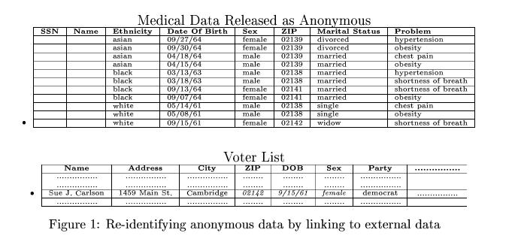
Latanya Sweeney’s Attack (1997)
Massachusetts hospital discharge dataset
Public voter dataset

Slide 35
Data Anonymization
Problem: protecting Personally Identifiable Information (PII) and their sensitive attributes
Quasi-identifier |  |  | Sensitive
DOB | Gender | Zipcode | Disease
1/21/76 | Male | 53715 | Heart Disease
4/13/86 | Female | 53715 | Hepatitis
2/28/76 | Male | 53703 | Brochitis
1/21/76 | Male | 53703 | Broken Arm
4/13/86 | Female | 53706 | Flu
2/28/76 | Female | 53706 | Hang Nail
Quasi-identifiers
need to be
generalized
or suppressed
Quasi-identifiers are sets of attributes that can be linked
with external data to uniquely identify an individual
Notes:
Only removing identifiers is not enough

Slide 36
Anonymity Set Size Metrics
The larger set of indistinguishable entities, the lower probability of identifying any one of them
  Can use to ”anonymize” a selected private attribute value within the domain of its all possible values
“Hiding in a crowd”
“Less” anonymous (1/4)
“More” anonymous (1/n)

Slide 37
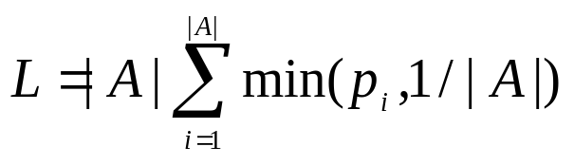
Anonymity Set
Anonymity set A
A = {(s₁, p₁), (s₂, p₂), …, (s_{n}, p_{n})}
  s_{i}: subject i who might access private data
  or: i-th possible value for a private data attribute
  p_{i}: probability that s_{i} accessed private data
  or: probability that the attribute assumes the i-th possible value
Effective anonymity set size is
  Maximum value of L is |A| iff all p_{i’}’s are equal to 1/|A|
  L below maximum when distribution is skewed
    skewed when p_{i’}’s have different values

Slide 38
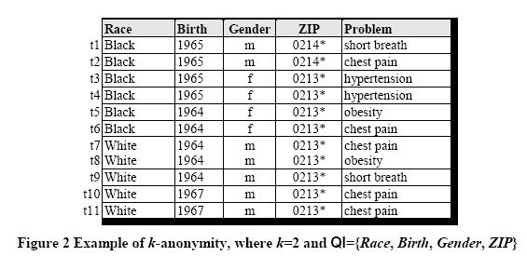
Solution: k-Anonymity
[Samarati et al. TR’98]
Quasi-identifiers indistinguishable among k individuals
Implemented by building generalization hierarchy or partitioning multi-dimensional data space
Homogeneity
attack
Equivalence class
share same QI
476**
2*
*
Tasia
Gender | Age
F | 51
47677
47602
47678
29
22
27
Male
Female
ZIP code
Age
Background
knowledge attack
Sex

Slide 39
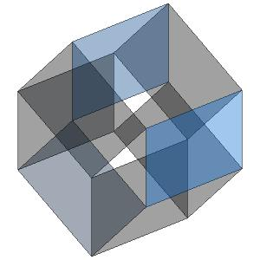
Curse of Dimensionality
[Aggarwal VLDB ‘05]
Generalization fundamentally relies
on spatial locality
  Each record must have k close neighbors
Real-world datasets are very sparse
  Many attributes (dimensions)
    Netflix Prize dataset: 17,000 dimensions
    Amazon customer records: several million dimensions
  “Nearest neighbor” is very far
Projection to low dimensions loses all info ⇒
k-anonymized datasets are useless

Slide 40
Enhanced Solution: l-Diversity
[Machanavajjhala et al. ICDE’06]
  At least l values for sensitive attributes in each equivalence class
Similarity attack
A 3-diverse patient table
Zipcode | Age | Salary | Disease
476** | 2* | 20K | Gastric Ulcer
476** | 2* | 25K | Gastritis
476** | 2* | 30K | Stomach Cancer
4790* | ≥40 | 50K | Gastritis
4790* | ≥40 | 100K | Flu
4790* | ≥40 | 70K | Bronchitis
476** | 3* | 60K | Bronchitis
476** | 3* | 80K | Pneumonia
476** | 3* | 90K | Stomach Cancer
Bob
Zip | Age
47678 | 27
Skewness attack
Conclusion
Bob’s salary is in [20k,40k], which is relatively low
Bob has some stomach-related disease

Slide 41
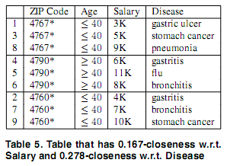
Enhanced Solution: t-Closeness
[Li et al. ICDE’07]
“Distribution of sensitive attributes within each quasi-identifier group should be “close” to their distribution in the entire original database” ->
  Distance between overall distribution of sensitive attribute values and distribution of sensitive attribute values in an equivalence class bounded by t

Slide 42

What Does Attacker Know?
Bob is Caucasian and
I heard he was
admitted to hospital
with flu…
Caucas | 787XX | HIV+ | Flu
Asian/AfrAm | 787XX | HIV- | Flu
Asian/AfrAm | 787XX | HIV+ | Shingles
Caucas | 787XX | HIV- | Acne
Caucas | 787XX | HIV- | Shingles
Caucas | 787XX | HIV- | Acne
This is against the rules!
“flu” is not a quasi-identifier
Yes… and this is yet another
problem with k-anonymity

Slide 43
k-Anonymity: limitations
Syntactic
  Focuses on data transformation, not on what can be learned from the anonymized dataset
  “k-anonymous” dataset can leak sensitive information
“Quasi-identifier” fallacy
  Assumes a priori that attacker will not
  know certain information about his target
Relies on locality
  Possible harmful to the utility of many real-world datasets

Slide 44



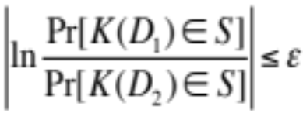
Differential Privacy for Statistical Data
[Dwork ICALP’06]
Strong privacy guarantees while querying a database
Query
A
P(A)
Indistiguishable!
PERTURBATION
Query
A’
P(A’)
PERTURBATION
A randomized function K gives ε-Differential Privacy IFF for all datasets D₁ and D₂ differing on at most one element, and all S Range (K)
Notes:
The probability of obtaining the same answer with the two datasets is close.

Slide 45
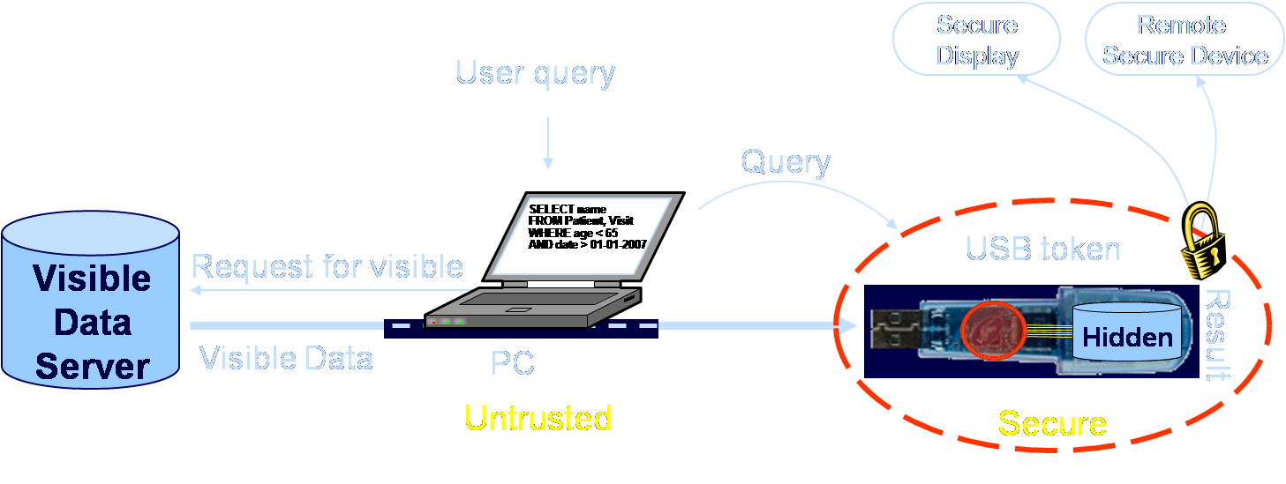
Secure Devices for Privacy
[Anciaux et al. SIGMOD’07]
Problem: protecting private data during queries involving both private (hidden) and public (visible) data
Solution: carry private data in a secure USB key, ensure private data never leaves the USB key, and only public data flows to the key
Query optimization for small RAM USB key
4/11/2013
ICDE 2013 Tutorial

Slide 46
Data privacy in future

Slide 47
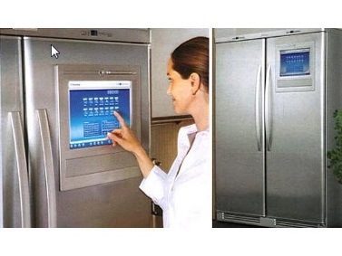
Privacy in Pervasive Computing
In pervasive computing environments, socially-based paradigms (incl. trust) will play a big role
People surrounded by zillions of computing devices of all kinds, sizes, and aptitudes [“Sensor Nation: Special Report,” IEEE Spectrum, vol. 41, no. 7, 2004 ]
  Most with limited / rudimentary capabilities
    Quite small, e.g., RFID tags, smart dust
  Most embedded in artifacts for everyday use, or even human bodies
    Possible both beneficial and detrimental (even apocalyptic) consequences
Danger of malevolent opportunistic sensor networks
— pervasive devices self-organizing into huge spy networks
  Able to spy anywhere, anytime, on everybody and everything
  Need means of detection & neutralization
    To tell which and how many snoops are active, what data they collect, and who they work for
      An advertiser? a nosy neighbor? Big Brother?
    Questions such as “Can I trust my refrigerator?” will not be jokes
      The refrigerator snitching on its owner’s dietary misbehavior for her doctor

Slide 48
Using Trust for Privacy Protection
Privacy = entity’s ability to control the availability and exposure of information about itself
  extended the subject of privacy from a person in the original definition [“Internet Security Glossary,” The Internet Society, Aug. 2004 ] to an entity— including an organization or software
    Important in pervasive computing
Privacy and trust are closely related
  Trust is a socially-based paradigm
  Privacy-trust tradeoff: Entity can trade privacy for a corresponding gain in its partners’ trust in it
  The scope of an entity’s privacy disclosure should be proportional to the benefits expected from the interaction
    As in social interactions
    E.g.: a customer applying for a mortgage must reveal much more personal data than someone buying a book

Slide 49
Selected Publications
“Private and Trusted Interactions,” by B. Bhargava and L. Lilien.
“On Security Study of Two Distance Vector Routing Protocols for Mobile Ad Hoc Networks,” by W. Wang, Y. Lu and B. Bhargava, Proc. of IEEE Intl. Conf. on Pervasive Computing and Communications (PerCom 2003), Dallas-Fort Worth, TX, March 2003. http://www.cs.purdue.edu/homes/wangwc/PerCom03wangwc.pdf
“Fraud Formalization and Detection,” by B. Bhargava, Y. Zhong and Y. Lu, Proc. of 5th Intl. Conf. on Data Warehousing and Knowledge Discovery (DaWaK 2003), Prague, Czech Republic, September 2003. http://www.cs.purdue.edu/homes/zhong/papers/fraud.pdf
“Trust, Privacy, and Security. Summary of a Workshop Breakout Session at the National Science Foundation Information and Data Management (IDM) Workshop held in Seattle, Washington, September 14 - 16, 2003” by B. Bhargava, C. Farkas, L. Lilien and F. Makedon, CERIAS Tech Report 2003-34, CERIAS, Purdue University, November 2003.
http://www2.cs.washington.edu/nsf2003 or
https://www.cerias.purdue.edu/tools_and_resources/bibtex_archive/archive/2003-34.pdf
“e-Notebook Middleware for Accountability and Reputation Based Trust in Distributed Data Sharing Communities,” by P. Ruth, D. Xu, B. Bhargava and F. Regnier, Proc. of the Second International Conference on Trust Management (iTrust 2004), Oxford, UK, March 2004. http://www.cs.purdue.edu/homes/dxu/pubs/iTrust04.pdf
“Position-Based Receiver-Contention Private Communication in Wireless Ad Hoc Networks,” by X. Wu and B. Bhargava, submitted to the Tenth Annual Intl. Conf. on Mobile Computing and Networking (MobiCom’04), Philadelphia, PA, September - October 2004.
http://www.cs.purdue.edu/homes/wu/HTML/research.html/paper_purdue/mobi04.pdf

Slide 50
Selected Publications
1. The American Heritage Dictionary of the English Language, 4th ed., Houghton Mifflin, 2000.
2. B. Bhargava et al., Trust, Privacy, and Security: Summary of a Workshop Breakout Session at the National Science Foundation Information and Data Management (IDM) Workshop held in Seattle,Washington, Sep. 14–16, 2003, tech. report 2003-34, Center for Education and Research in Information Assurance and Security, Purdue Univ., Dec. 2003;
www.cerias.purdue.edu/tools_and_resources/bibtex_archive/archive/2003-34.pdf.
3. “Internet Security Glossary,” The Internet Society, Aug. 2004; www.faqs.org/rfcs/rfc2828.html.
4. B. Bhargava and L. Lilien “Private and Trusted Collaborations,” to appear in Secure Knowledge Management (SKM 2004): A Workshop, 2004.
5. “Sensor Nation: Special Report,” IEEE Spectrum, vol. 41, no. 7, 2004.
6. R. Khare and A. Rifkin, “Trust Management on the World Wide Web,” First Monday, vol. 3, no. 6, 1998; www.firstmonday.dk/issues/issue3_6/khare.
7. M. Richardson, R. Agrawal, and P. Domingos,“Trust Management for the Semantic Web,” Proc. 2nd Int’l Semantic Web Conf., LNCS 2870, Springer-Verlag, 2003, pp. 351–368.
8. P. Schiegg et al., “Supply Chain Management Systems—A Survey of the State of the Art,” Collaborative Systems for Production Management: Proc. 8th Int’l Conf. Advances in Production Management Systems (APMS 2002), IFIP Conf. Proc. 257, Kluwer, 2002.
9. N.C. Romano Jr. and J. Fjermestad, “Electronic Commerce Customer Relationship Management: A Research Agenda,” Information Technology and Management, vol. 4, nos. 2–3, 2003, pp. 233–258.

Slide 51
Course evaluation
For students:
• Direct to myWSU portal. The center of the page includes a BLUE COURSE EVALUATIONS window.
• Please complete the evaluations – thanks!

